Slide 1
High Density Neural Implant Cylindrical Packaging
Neuralink, US 2023/0063165 A1, Published 3/2/2023
7/26/2024

Slide 2





Background
Space of Neural Implants:
Large implants – prone to tissue damage
Constant pressure to reduce overall volume
Most electronic components – stacked on top of one another
Need compact, dense packaging
Accessibility of Neural Implants:
Power source - often charged wirelessly (via induction coil) to reduce infection risk
Data transmission - rely on radio transmission
High-performance, specialized chips needed for collecting/processing neural signals

Slide 3
Outline
Goal: Describe space-saving configuration of BCI with >= 4 circuit boards forming sides of >= 5-sided geometric prism
Embodiments:
Side-Top view of Assembly of Cylindrically Wrapped Electronics with Chassis
Arrangements of Circuit Boards to form various Geometric Prisms
Side-Top view of Assembly of Cylindrical Power Coil
Side-Top view of Assembly of Cylindrically Wrapped Electronics and Circular Circuit Board
Side-Top view of Assembly of Cylindrically Wrapped Electronics with Chassis, Circular Circuit Board, and Battery
Side-Top view of Ferrimagnetic Cup and Cylindrical Power Coil Assembly
Side-Top view of Ferrimagnetic Cup, Circular Loop Antenna, and Cylindrical Power Coil Assembly
Bottom view of Ferrimagnetic Cup and Circular Circuit Board Assembly including Alignment Features
Side-Bottom Cutaway view of Assembly of Ferrimagnetic Cup + Cylindrically Wrapped Electronics including Alignment Features
Vertical Cross-Section of High-Density Neural Implant

Slide 4
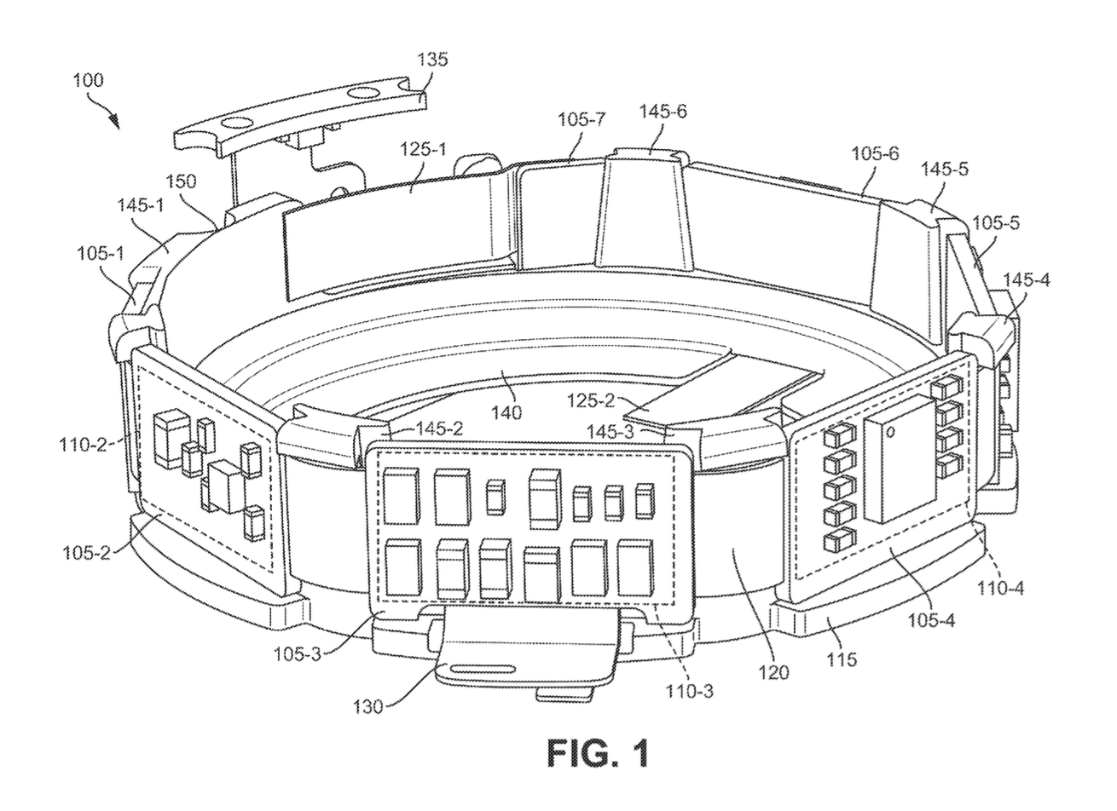



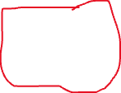
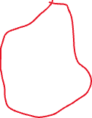



Side-Top view of Assembly of Cylindrically Wrapped Electronics with Chassis
Notch
(align chassis with other components)
Antenna connector
(couples circuit boards with radio antenna)
Power connectors
(connect to button-cell battery)
Support structures
7 Circuit boards (PCBs)
(Arranged cylindrically to form a polygon base prism sides)
Circular base
Electrical components
(e.g., resistors, transistors, inductors, etc.)
Power coil connector
(wireless charging coil – charge battery)
Chassis
(restrain each component to form prism)
Flex cables
(connect circuit boards)

Slide 5
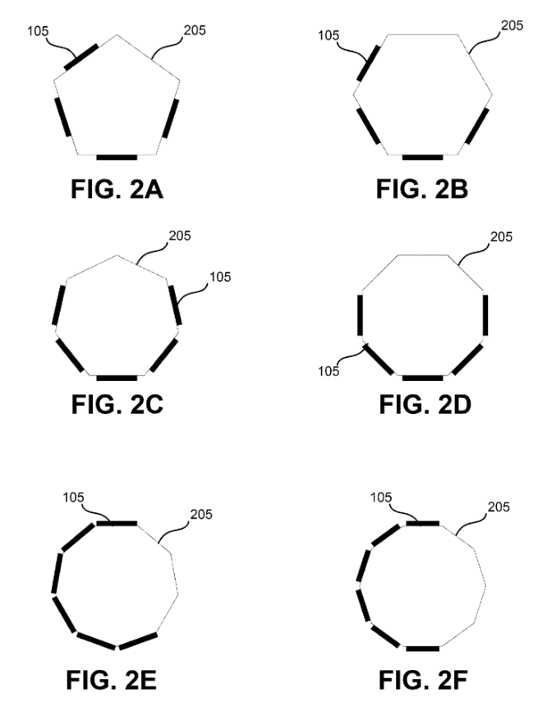

Arrangements of Circuit Boards to Form Various Geometric Prisms
Circuit board
Polygon base
At least 4 circuit boards
Boards – wrapped at least halfway

Slide 6
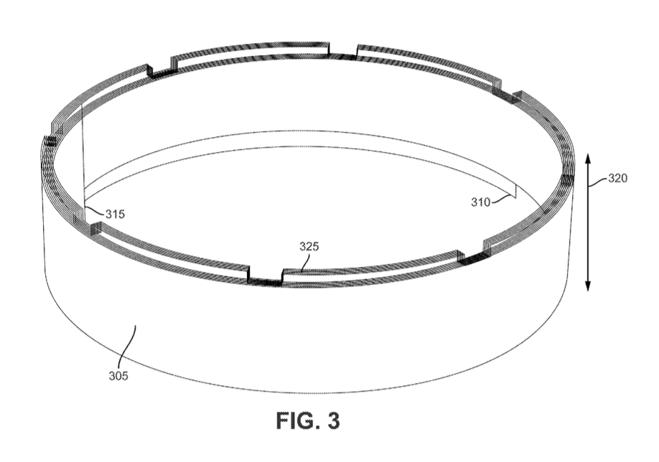
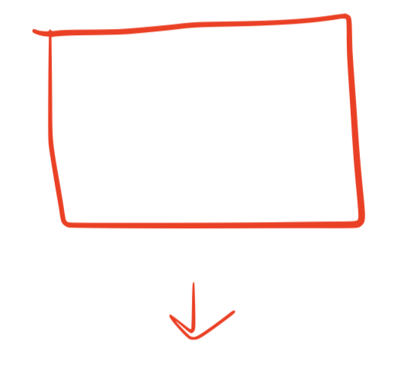
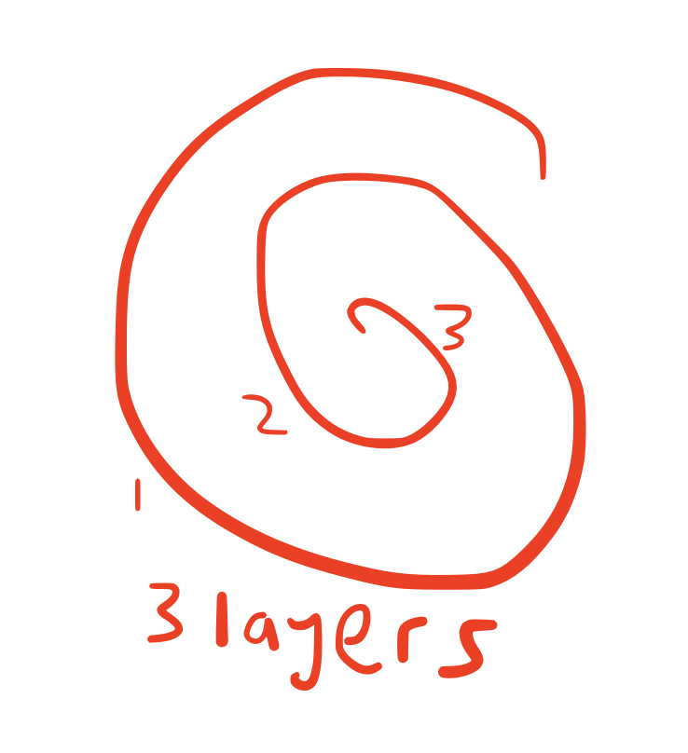
Side-Top view of Assembly of Cylindrical Power Coil
Cylindrical-wrapped coil:
Reduces overall height
Less loss at lower total volume (higher surface-area vs volume ratio)
Height
2nd End
1st End
Layers
Power coil
Aluminum, copper, silver, gold, etc.
Conduct power to electrical components

Slide 7
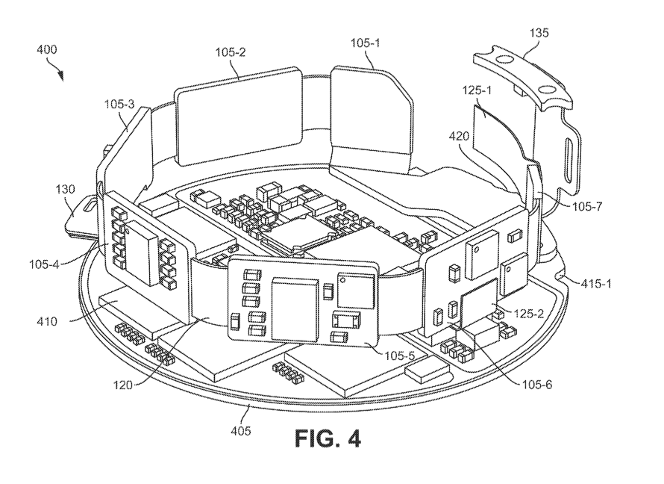

Side-Top view of Assembly of Cylindrically Wrapped Electronics and Circular Circuit Board
Connector
(distribute power from circular circuit board to individual circuit boards)
Antenna connector
Power coil connector
Notch
(for alignment)
IC chips
(e.g., ASIC, FPGA, etc.)
Power connector
Flex cables
Circuit board
Circular circuit board
(any PCB)

Slide 8
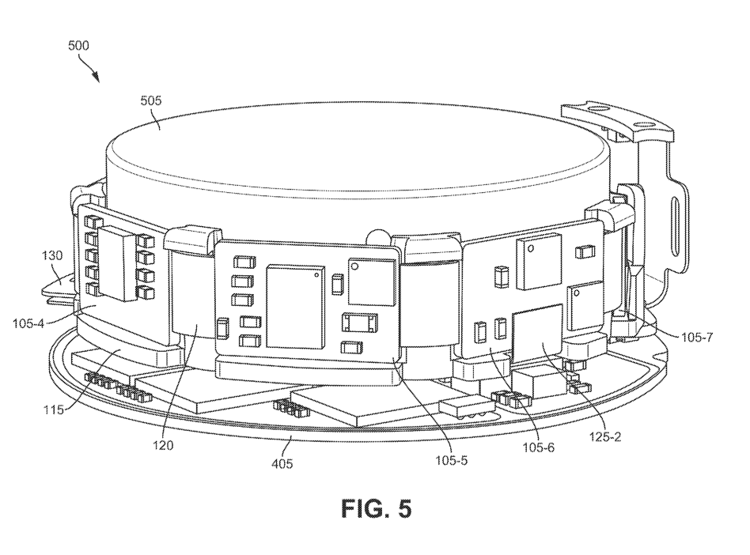
Side-Top view of Assembly of Cylindrically Wrapped Electronics with Chassis, Circular Circuit Board, and Battery
Cylindrical button battery
Provide power to 1+ optical components disposed on a plurality of circuit boards
Includes cathode casing + anode cap
Power coil connector
Chassis
Flex cables
Power connector
Circular circuit board
Circuit board

Slide 9
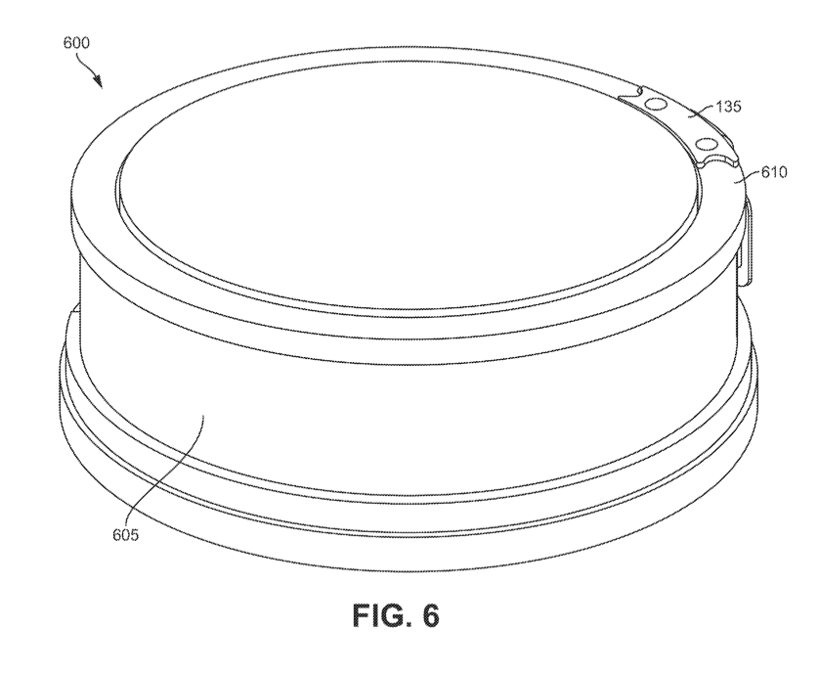
Side-Top view of Ferrimagnetic Cup and Cylindrical Power Coil Assembly
Antenna connector
Radio antenna
Circular loop – reduce overall height
Large diameter – better average gain, more uniform beam pattern
Ferrimagnetic cup
Made of sintered ferrite
Shields components within cup from external electromagnetic interference (EMI) via power coil
Shields EMI from interfering with functionality of radio antenna/leaking into neural pathways of patient

Slide 10
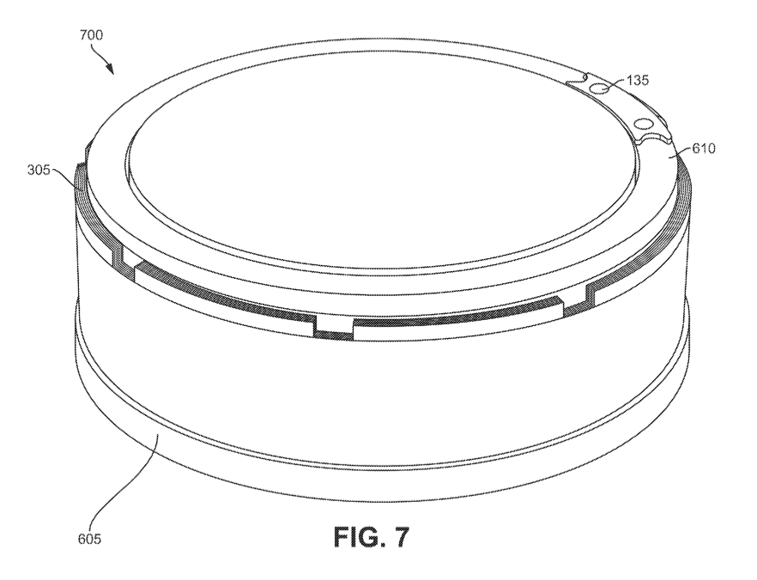
Side-Top view of Ferrimagnetic Cup, Circular Loop Antenna, and Cylindrical Power Coil Assembly
Antenna connector
Radio antenna
Power coil
Ferrimagnetic cup
(separates power coil from any circuit board(s) – reduce EMI from external coupling)

Slide 11
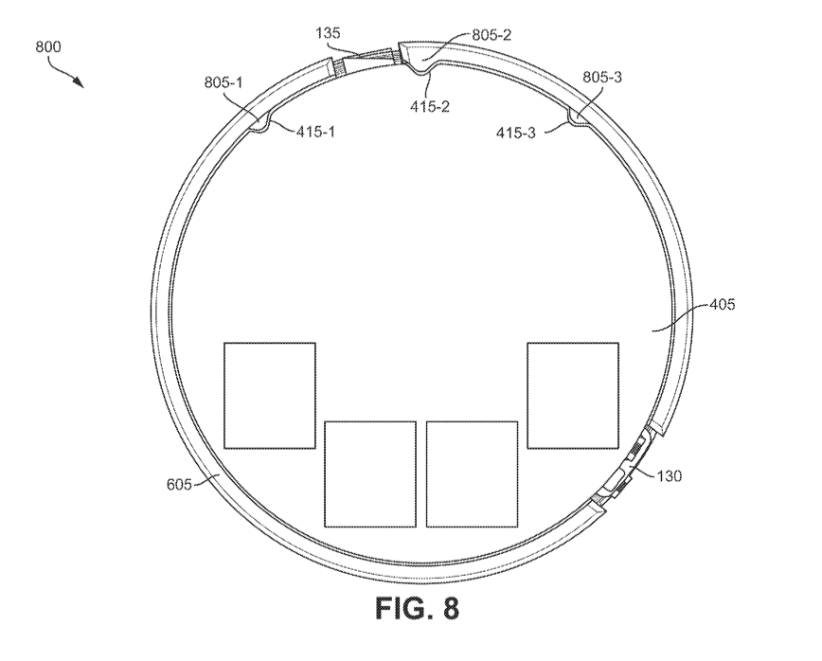





Bottom view of Ferrimagnetic Cup and Circular Circuit Board Assembly including Alignment Features
Antenna connector
Bump
Notch
Circular circuit board
Power coil connector
Ferrimagnetic cup

Slide 12
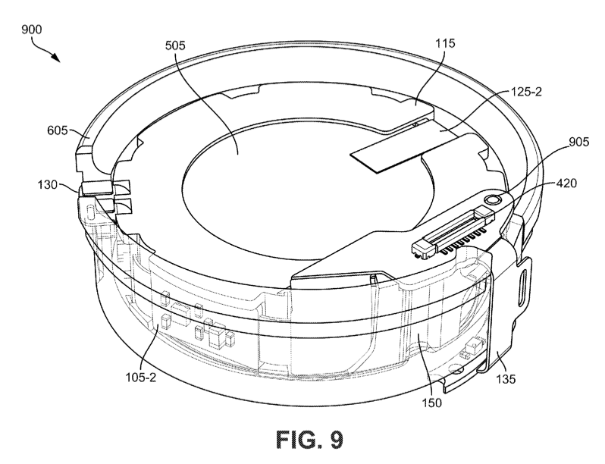
Side-Bottom Cutaway view of Assembly of Ferrimagnetic Cup + Cylindrically Wrapped Electronics including Alignment Features
Cylindrical button battery
Chassis
Power connector
Ferrimagnetic cup
Bump
(mate w/ opening of connector)
Power coil connector
Connector
Circuit board
Antenna connector
Notch

Slide 13
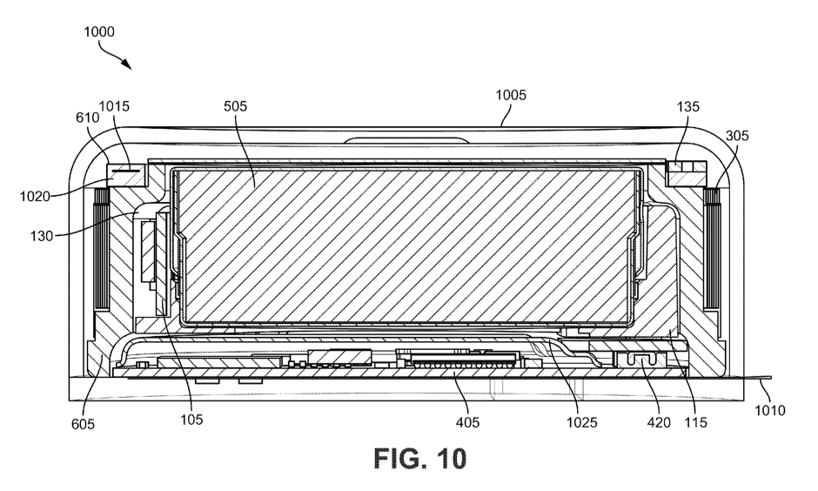
Vertical Cross-Section of High-Density Neural Implant
Housing
Any body-save material
Cylindrical
Height – maximize efficiency while reducing tissue erosion
Cylindrical button battery
Antenna connector
Conductor
Radio antenna
Power coil
Dielectric substrate
Power coil connector
Electrical leads
Passes thru opening of housing, into neural tissue
Transmit electrical impulses between surrounding tissue and components of neural implant
Ferrimagnetic cup
Circuit board
Metallic shield
Reduce EMI effects on electronic components
Reduce unwanted humidity accumulation
Chassis
Circular circuit board
Connector

Slide 14
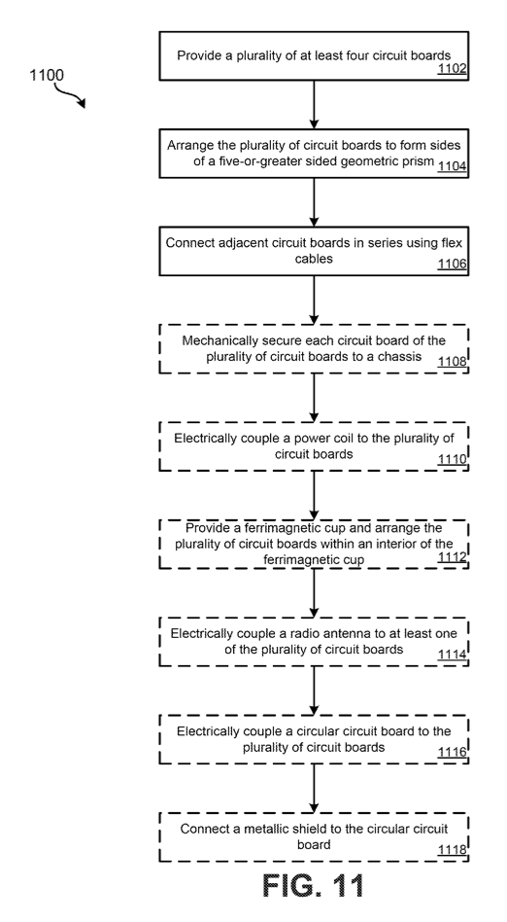
Flowchart for Manufacture

Slide 15

Step 1:

Slide 16
Step 2:

Slide 17

Step 3:
Flex cable

Slide 18
Step 4:
Chassis

Slide 19
Step 5:
Power coil

Slide 20
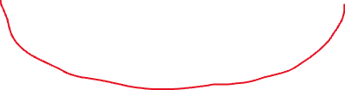


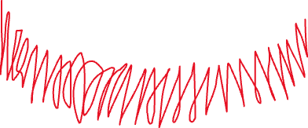
Step 6:
Ferrimagnetic cup

Slide 21
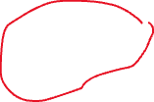
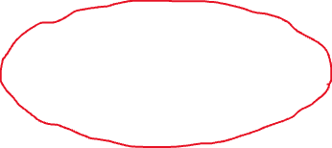
Step 7:
Antenna connector
Radio antenna

Slide 22




Step 8:
Circular circuit board

Slide 23

Step 9:
Metallic shield

